Slide 1
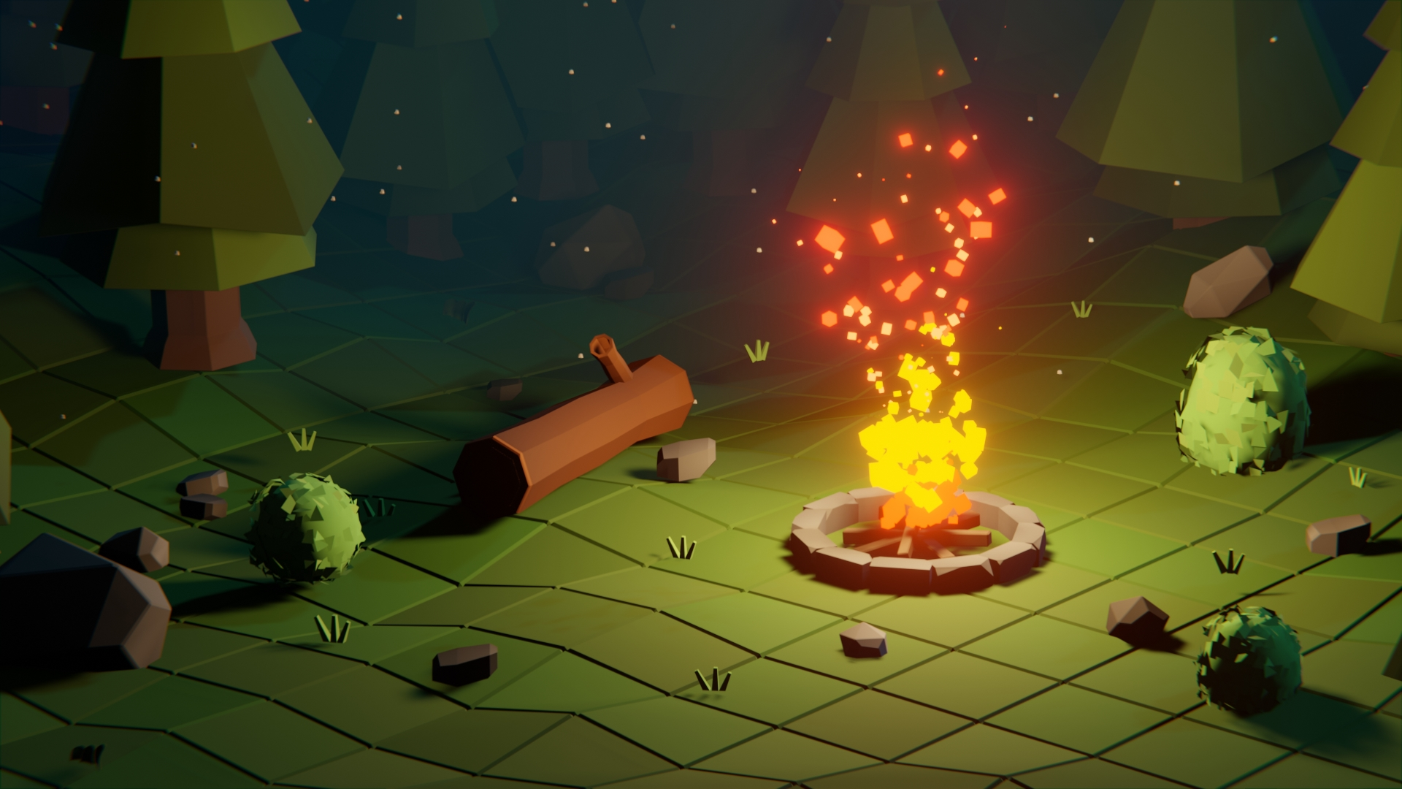
DIGITAL MEDIA PROJECT
Ashraya Singh Khatri
19031980
Internal Supervisor: Rakshak Bhushan Bajracharya
External Supervisor: Pooja Shrestha

Slide 2
Table of contents
Introduction
Aims and Objectives of the Project
Pre – Production
Production
Post- production
Testing and Evaluation
Conclusion

Slide 3
Introduction
The Digital Media Project presentation contains 10% of our module marks.
For this coursework, we students are required to complete our individual projects and submit the documentation, project files, research and production process of the product.
My project’s asset pack was created with the goal to provide an exciting and creative designs for aspiring new indie developers.

Slide 4
Aims and objectives of the project
One of the goal of my project is to create a low poly asset pack for the user, to lessen their production time
The asset pack is easily customizable, personalized and ready for gaming use.
I hope that the project will also motivate more individuals to learn and experiment with 3D.
The main objective of my asset pack is to provide a wide range of models which can be used in different settings of games.

Slide 5
Pre-production
This stage includes planning for the project. It includes the title of my project, the genre for the game, it’s targeted audience and the design and aesthetic for the game.
So, in order to make different models with their unique aesthetics, I have searched on distinct references for my project.

Slide 6
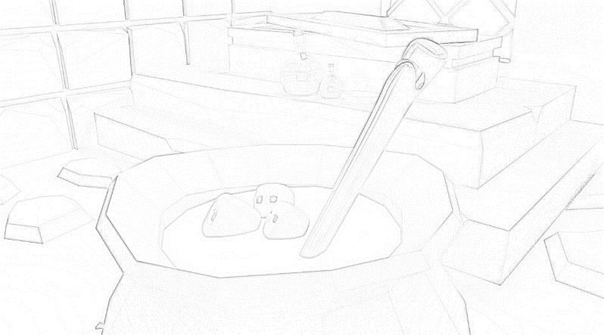
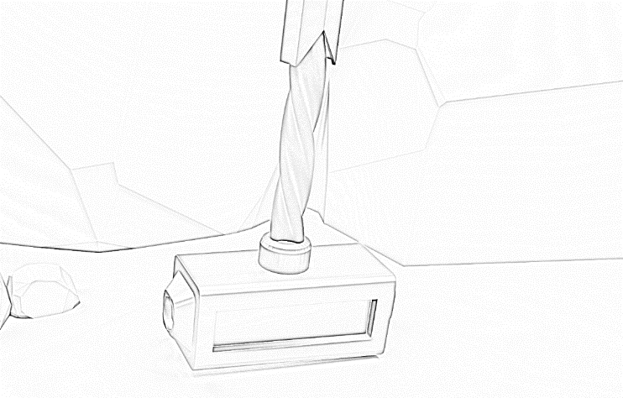
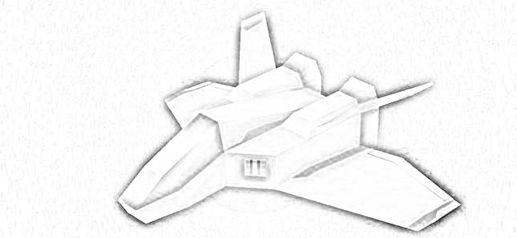
Concept Art

Slide 7
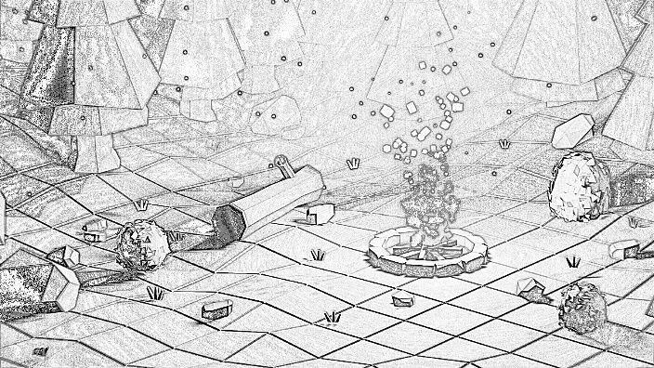
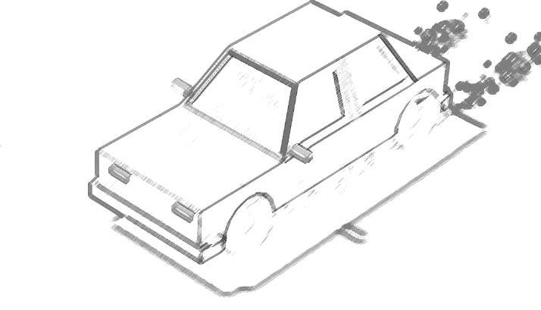

Slide 8
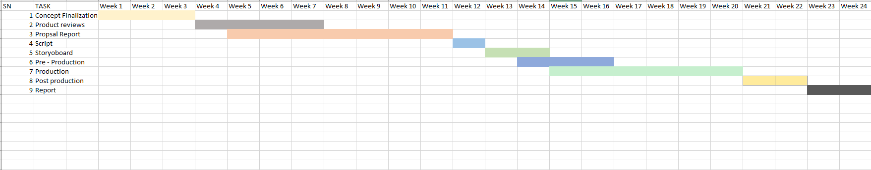
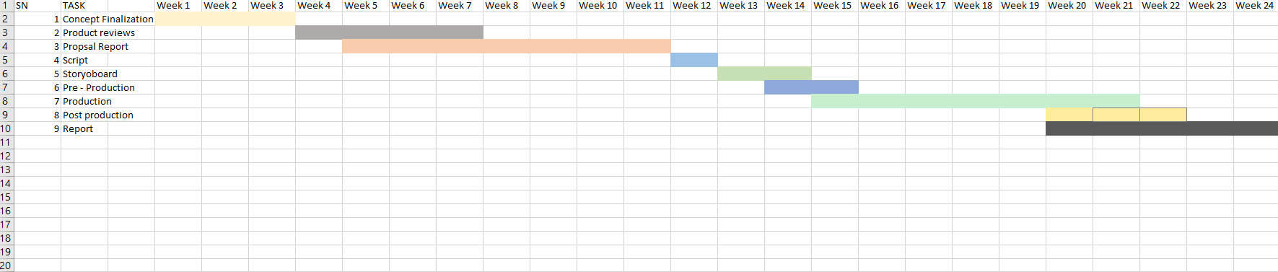
Project timeline and schedule

Slide 9
The production process was mentioned to start from week 15 to week 20. Thus, due to the project not being updated with the previous timeline the initial plan that was done for the DMP was updated with the new Gantt chart.
The production phase duration has increased giving more time to create models with proper shaders and lightning. Post-Production has been moved forward.

Slide 10
Production
This phase included where the game assets were starting to get modelled per the concept art of my pre- production stage.
In this stage all the aspects of the products are created and enhanced.

Slide 11
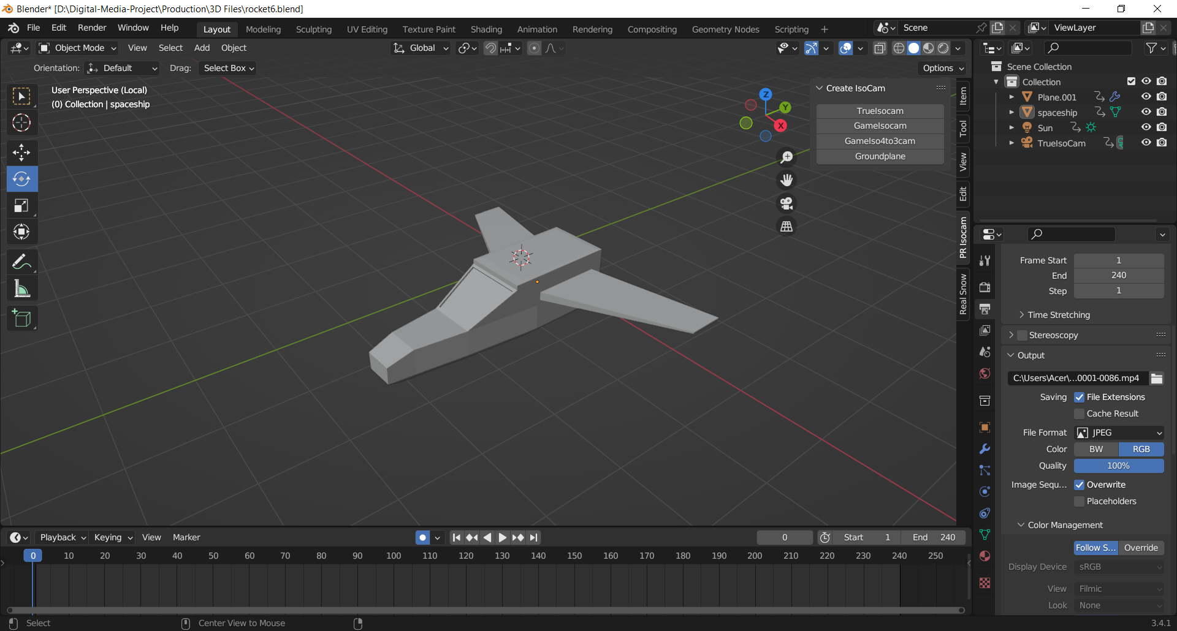
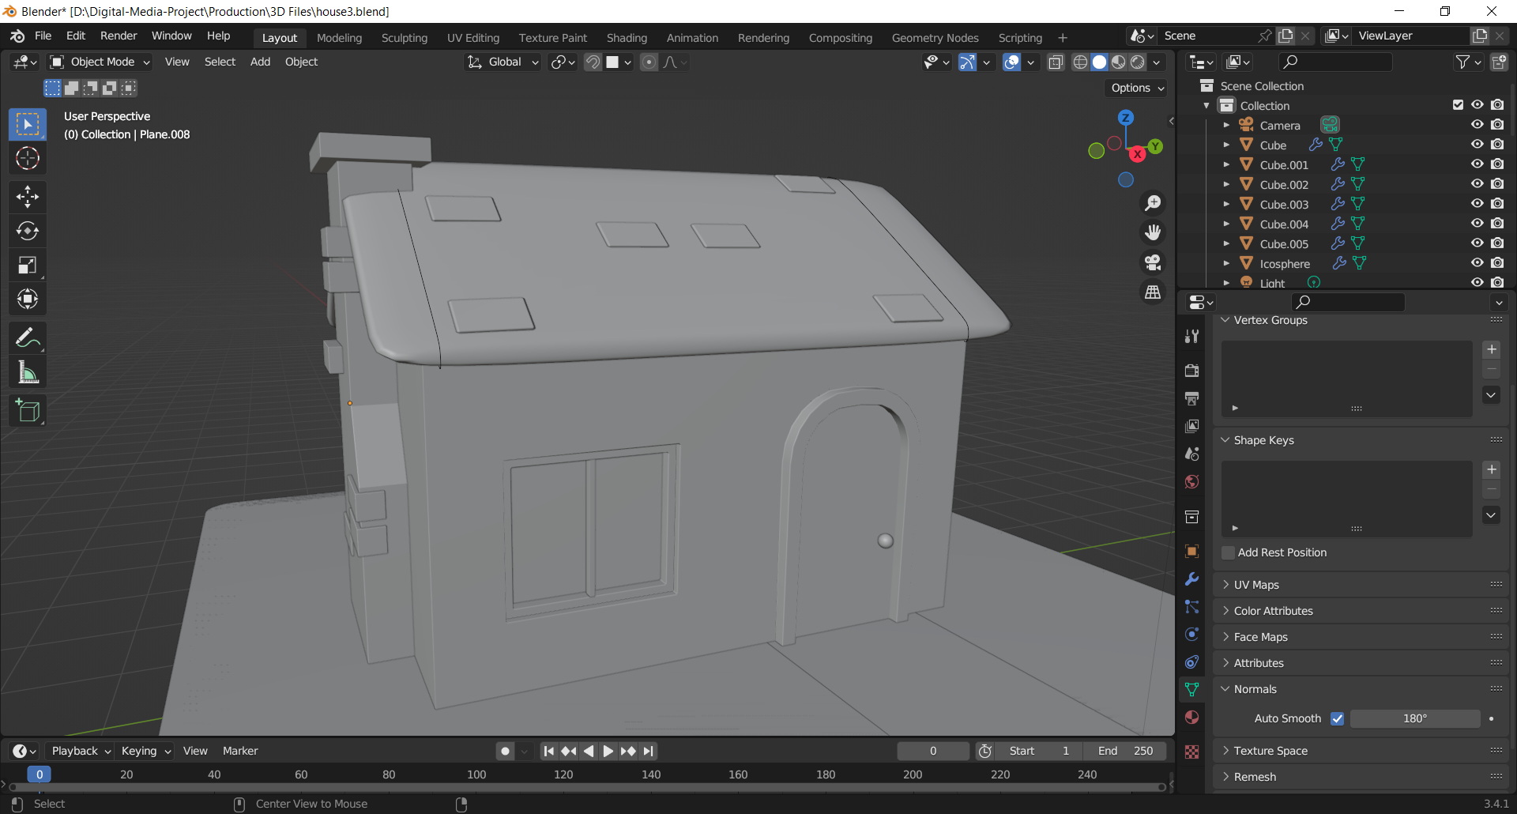
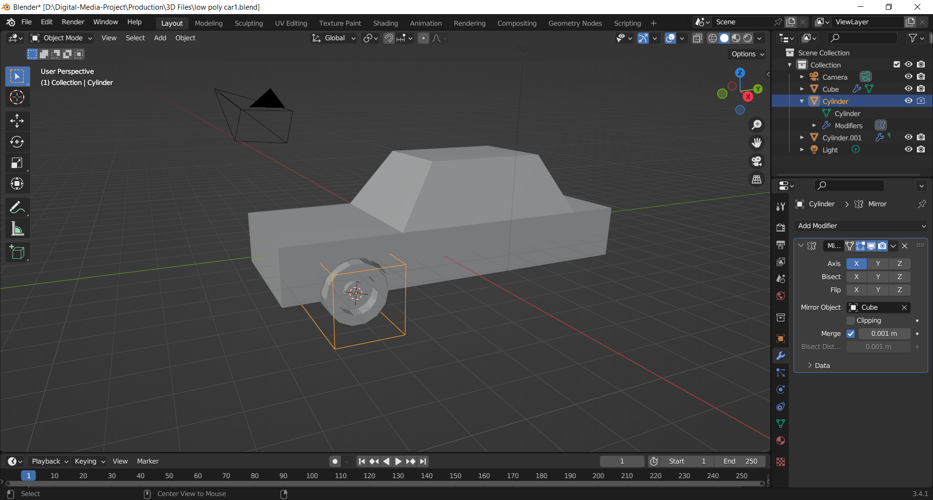
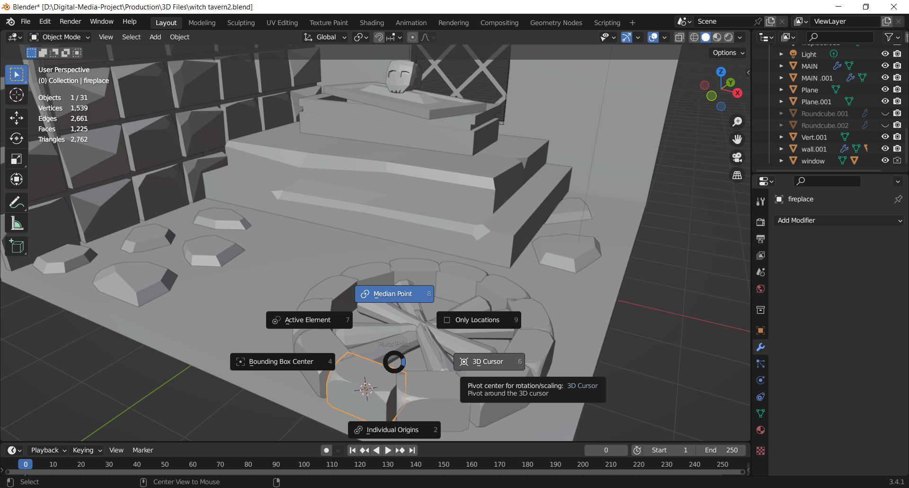
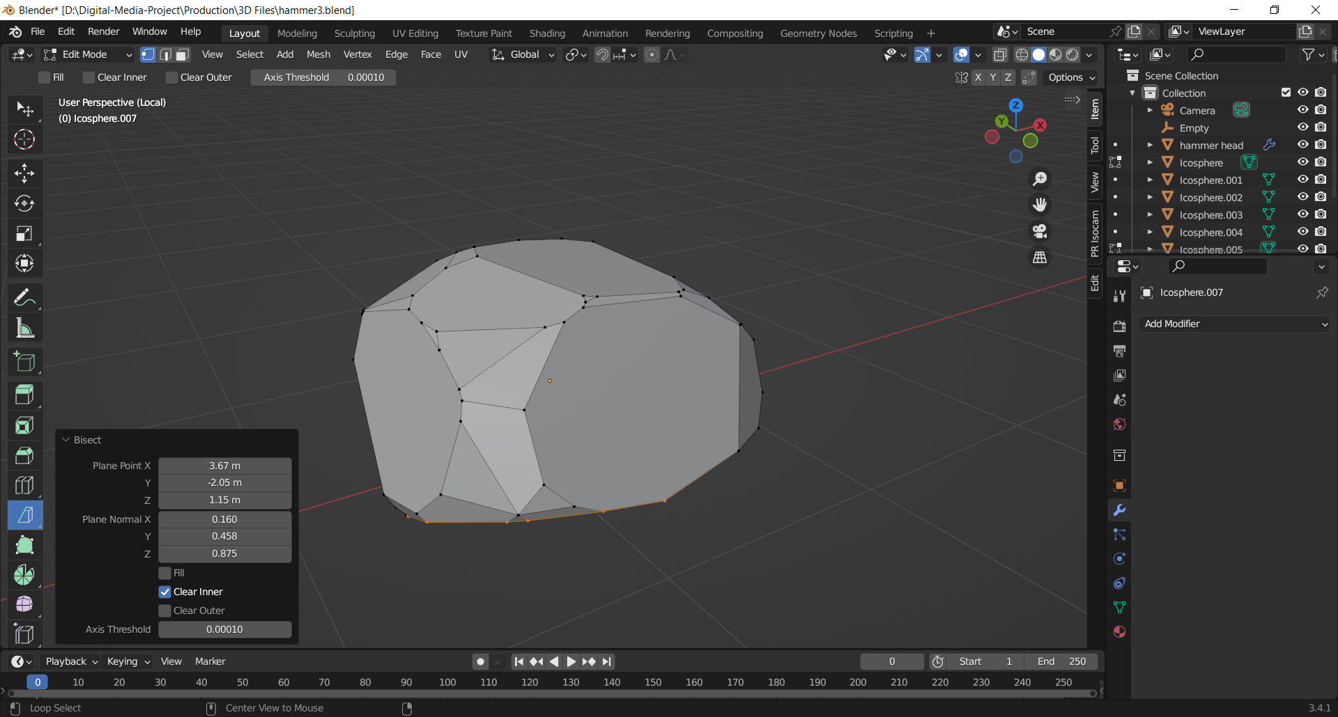
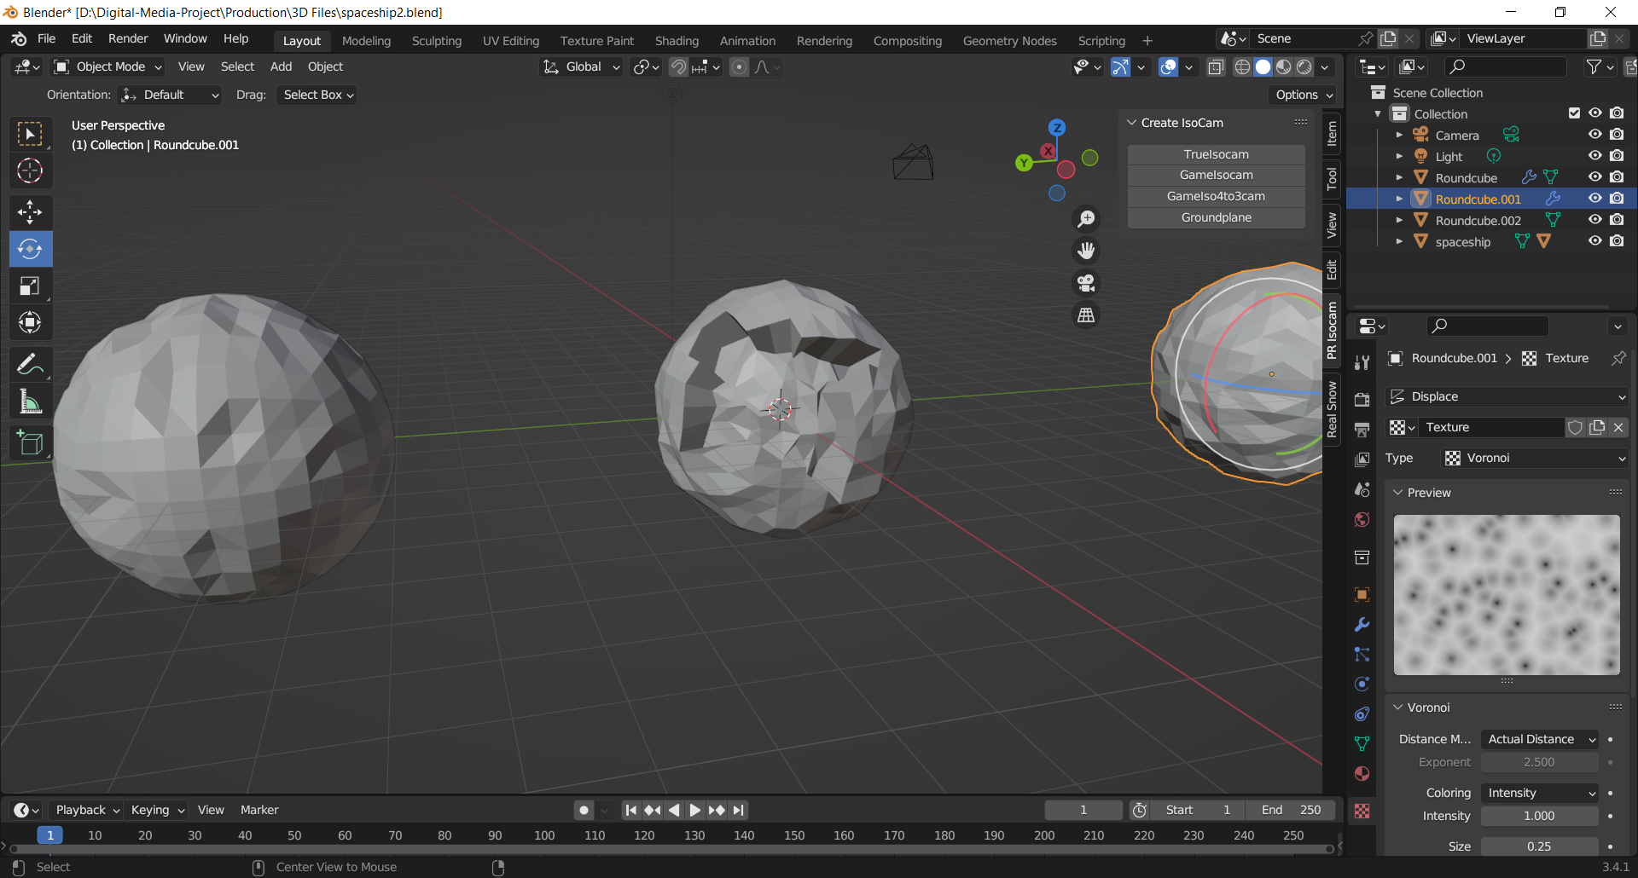
Modelling/Asset creations

Slide 12
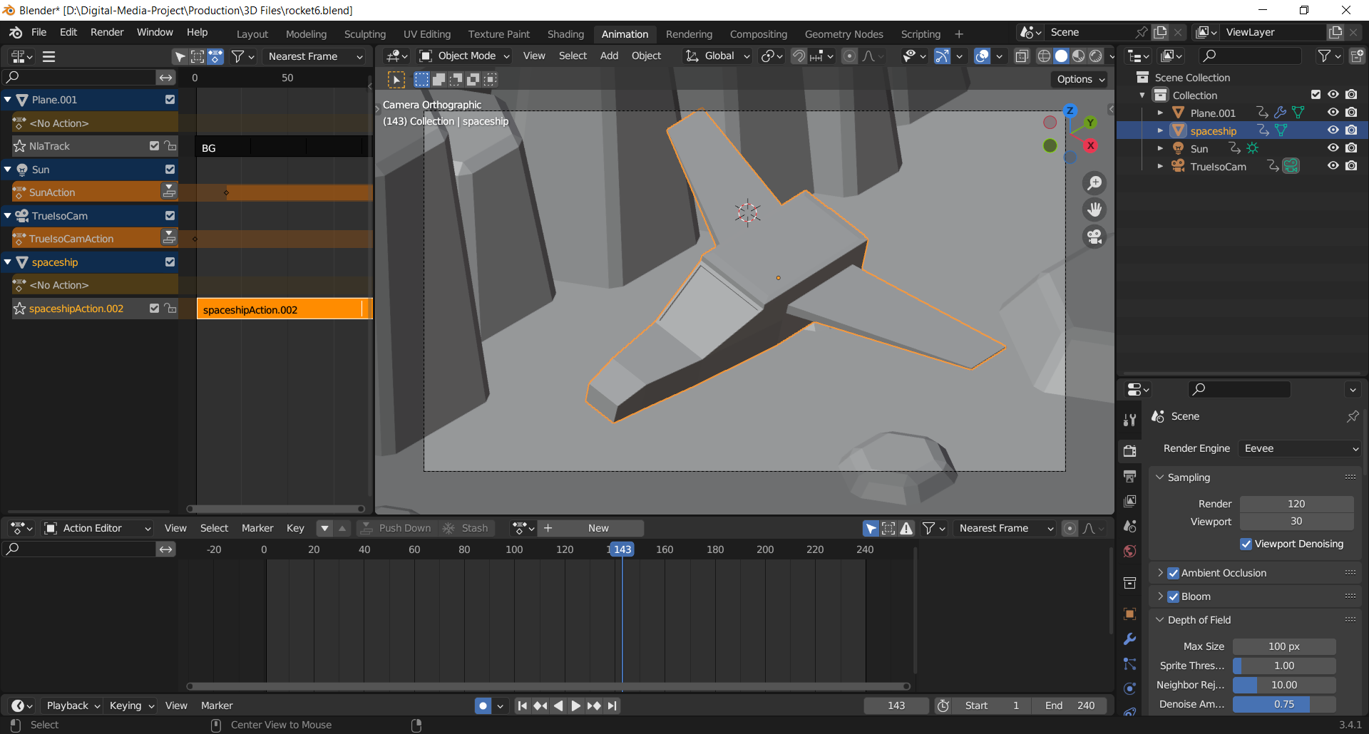
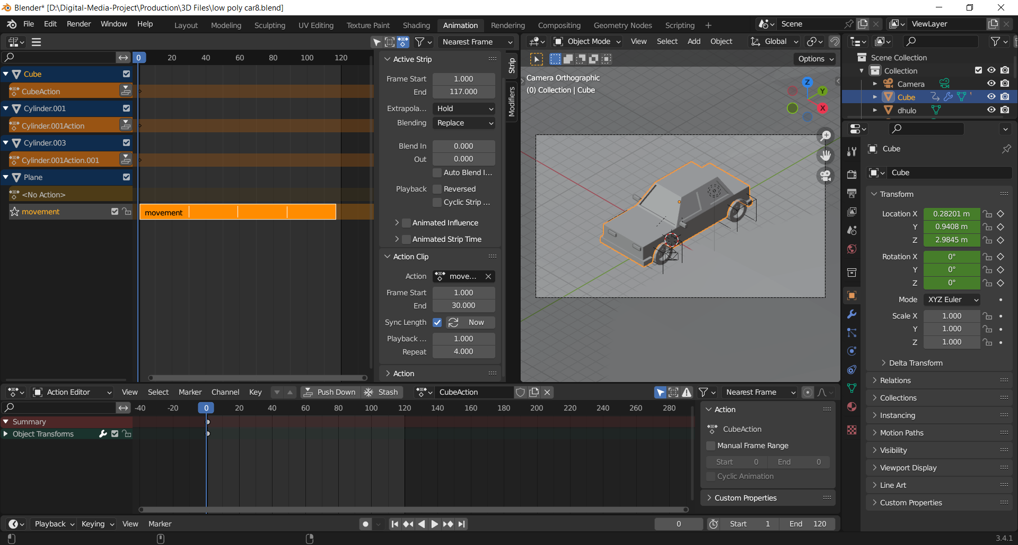
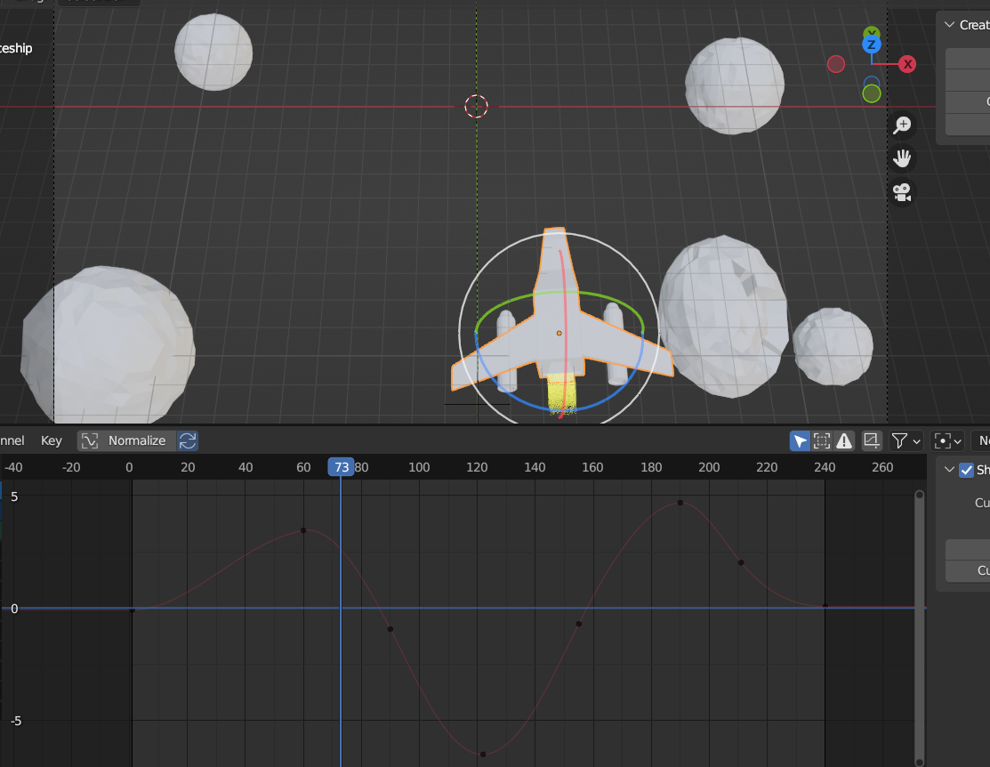
Animation loops and Particle effects

Slide 13
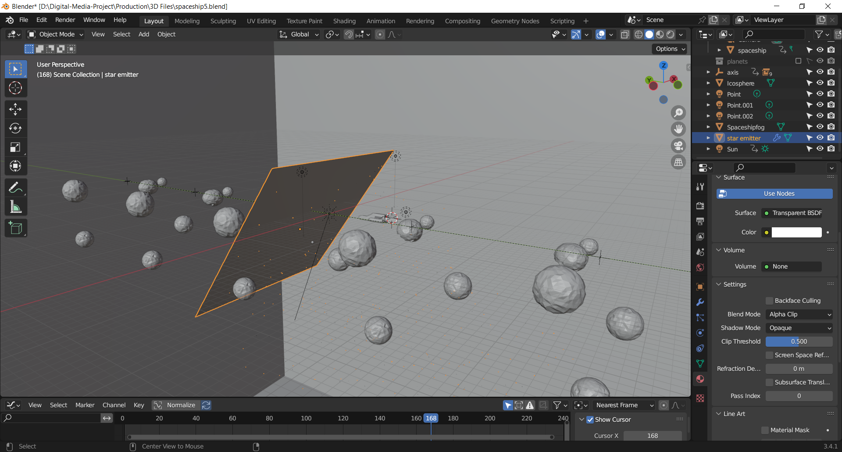
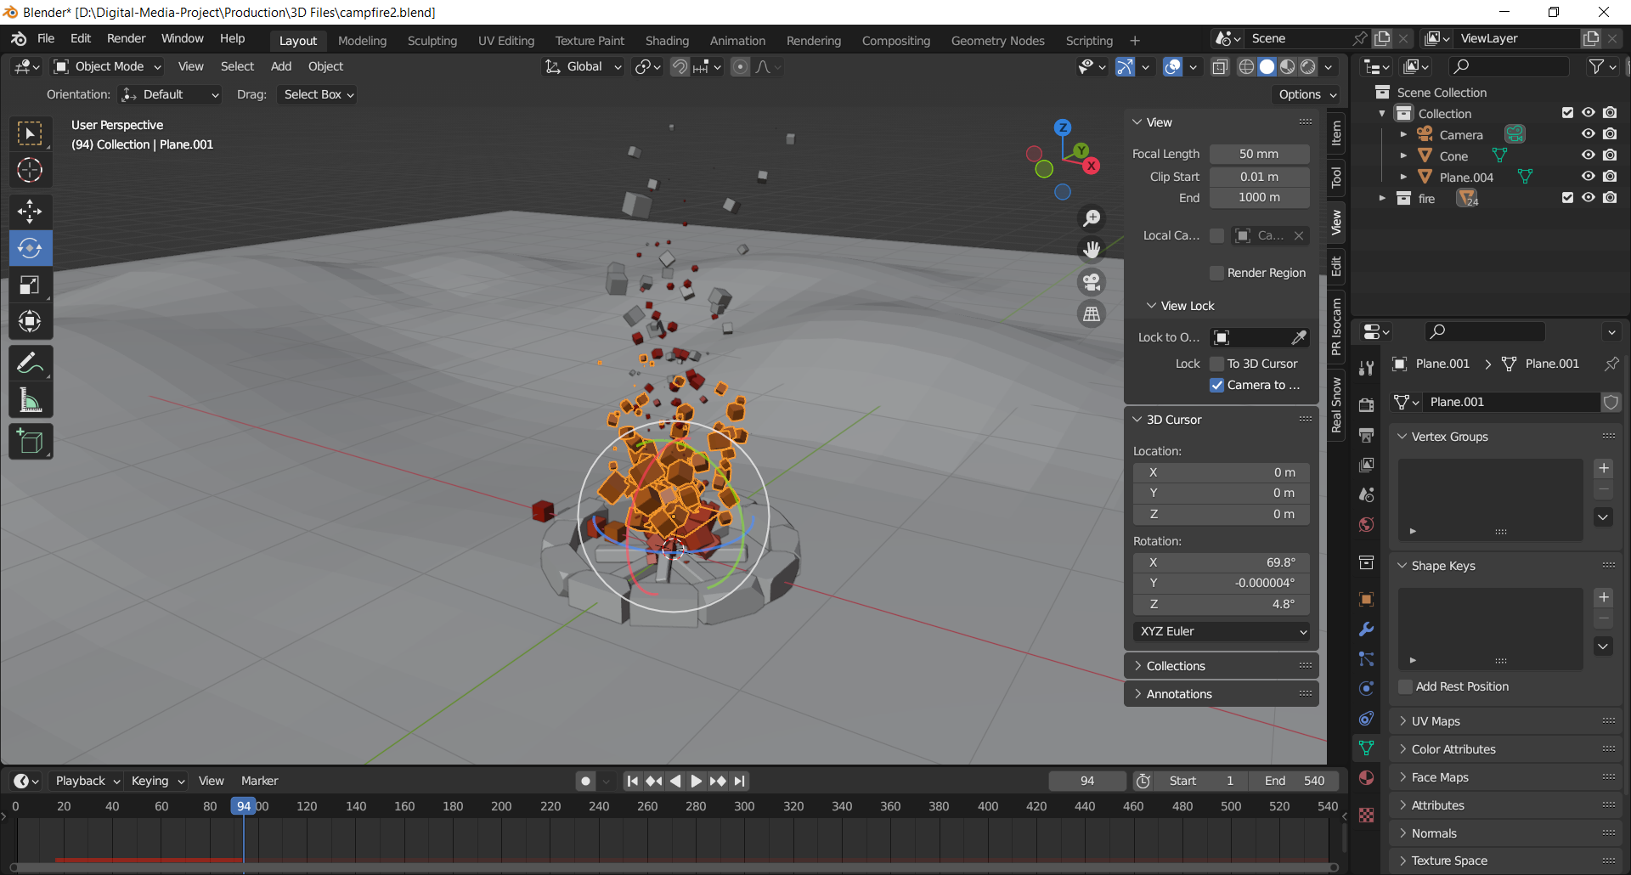
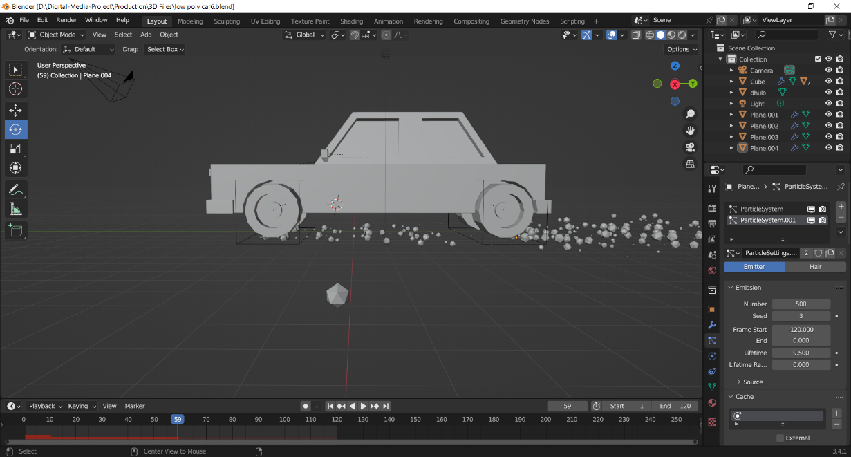

Slide 14
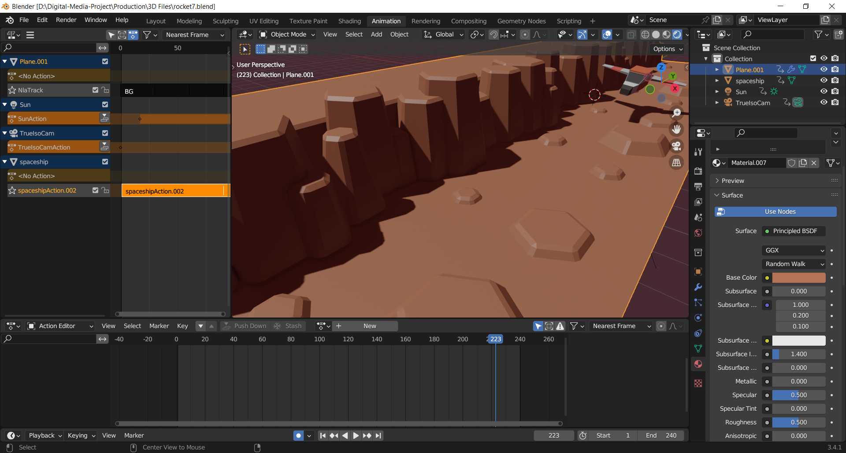
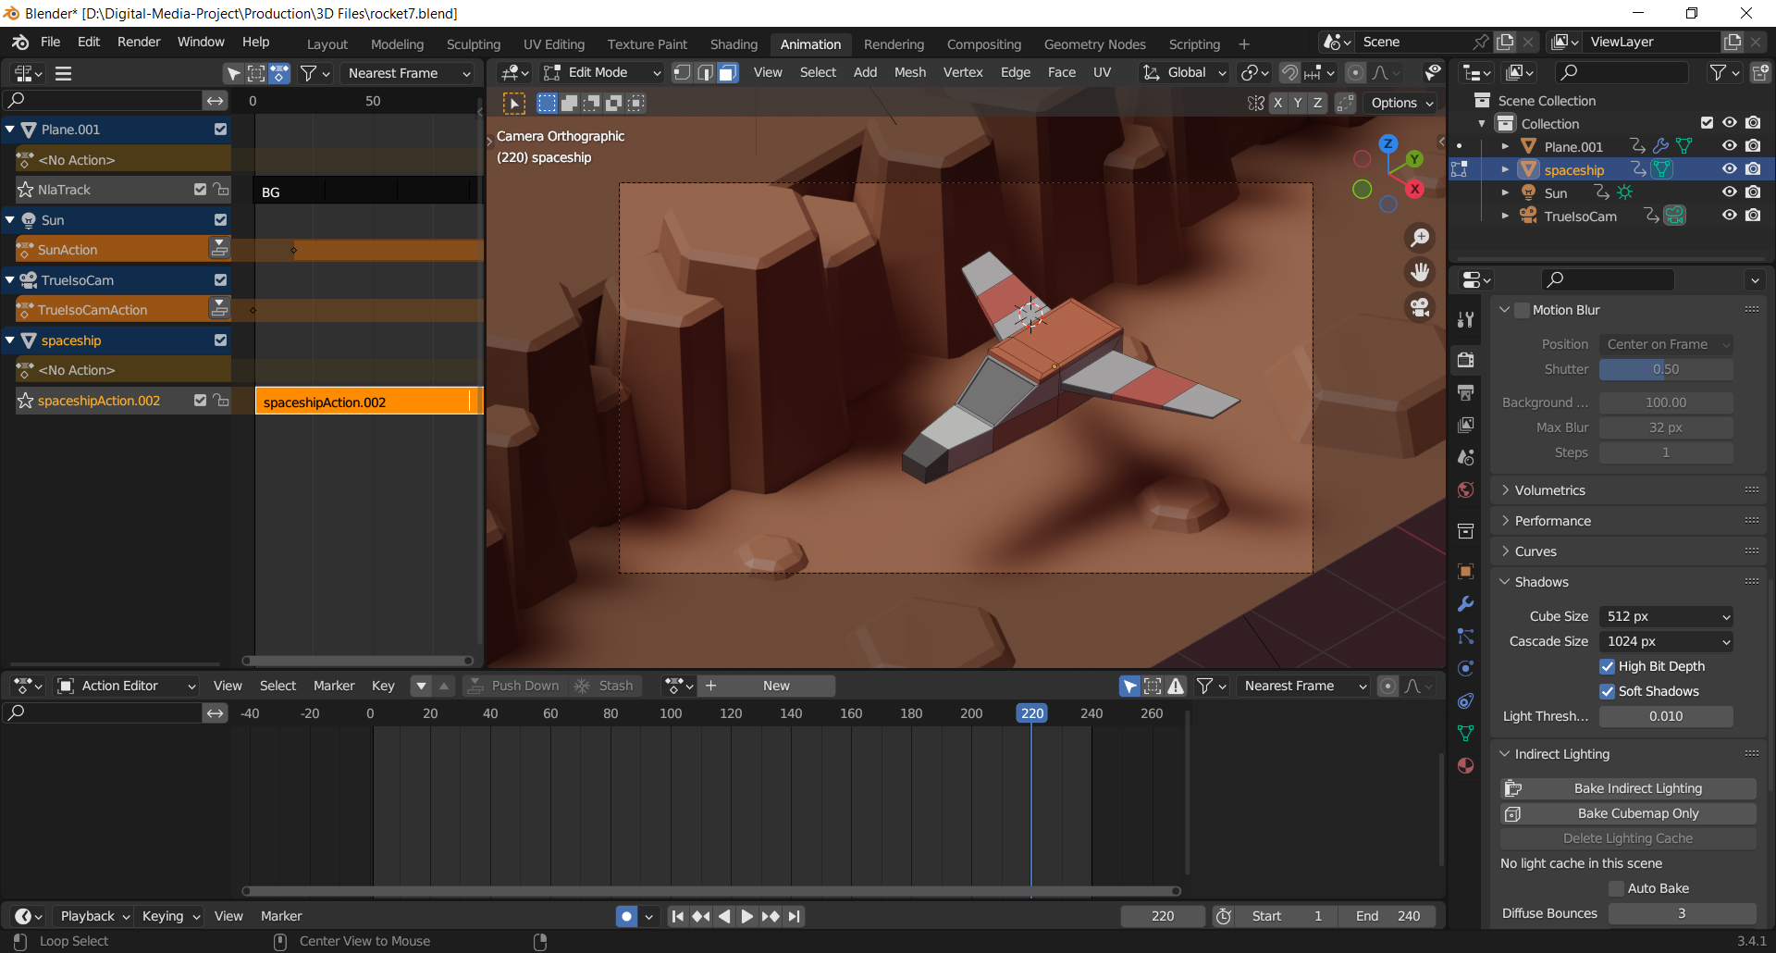
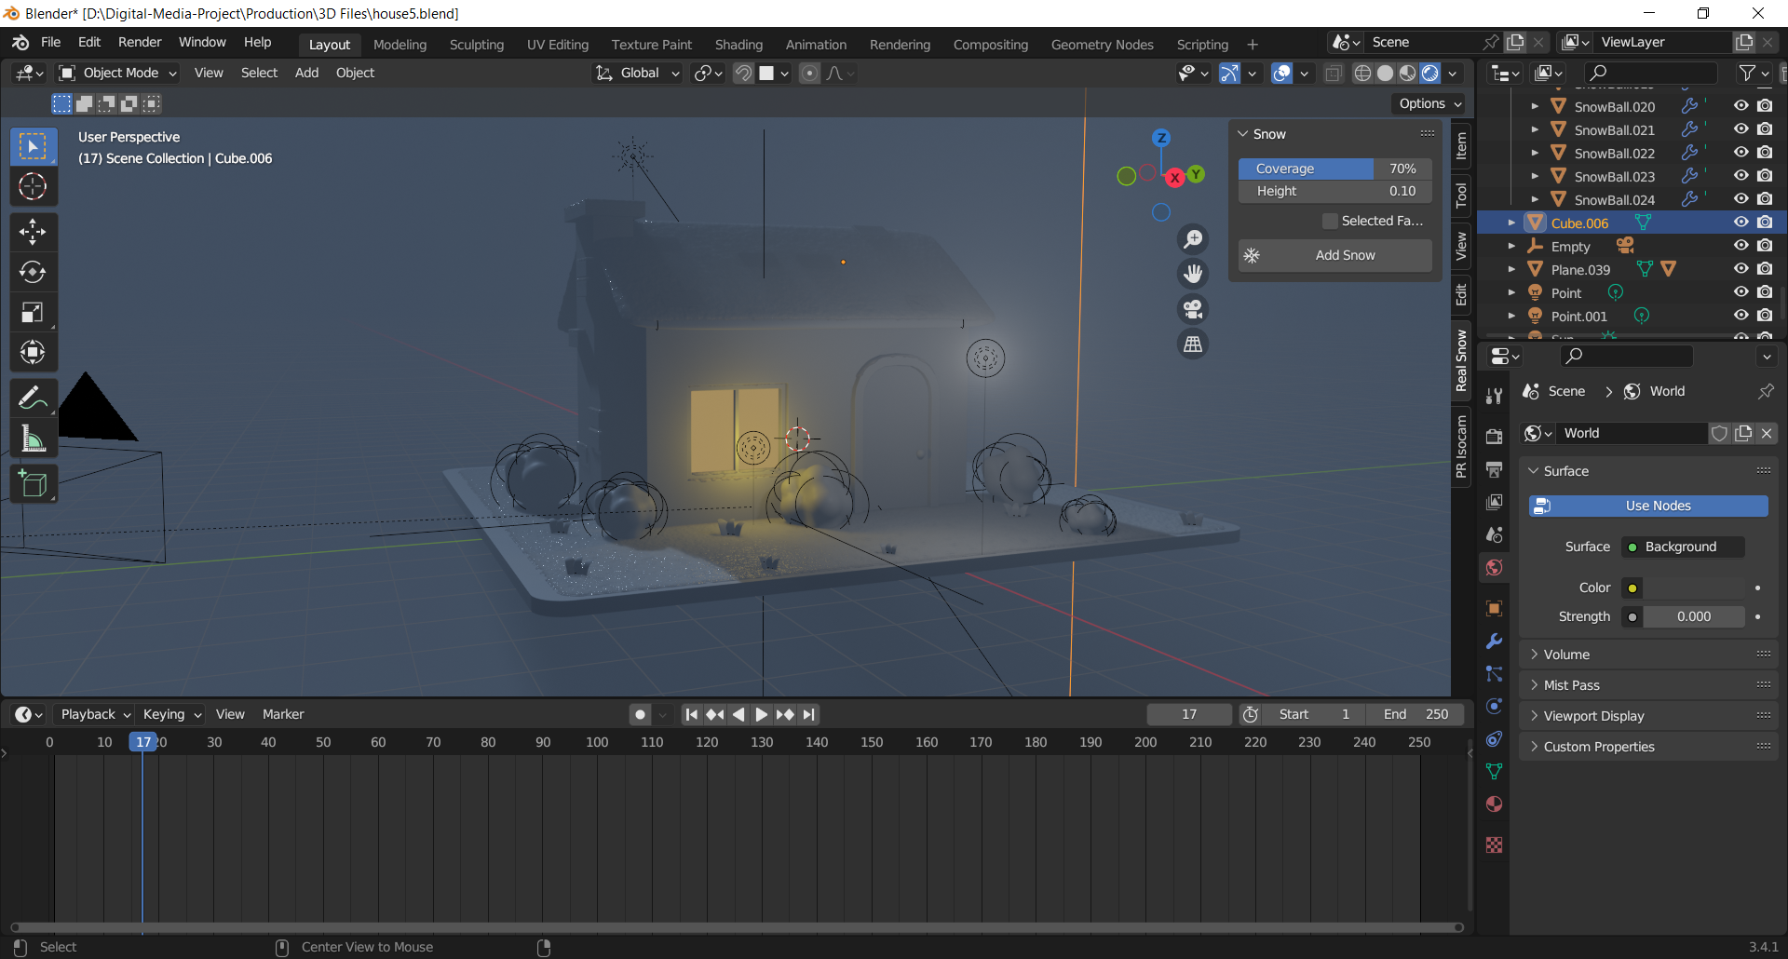
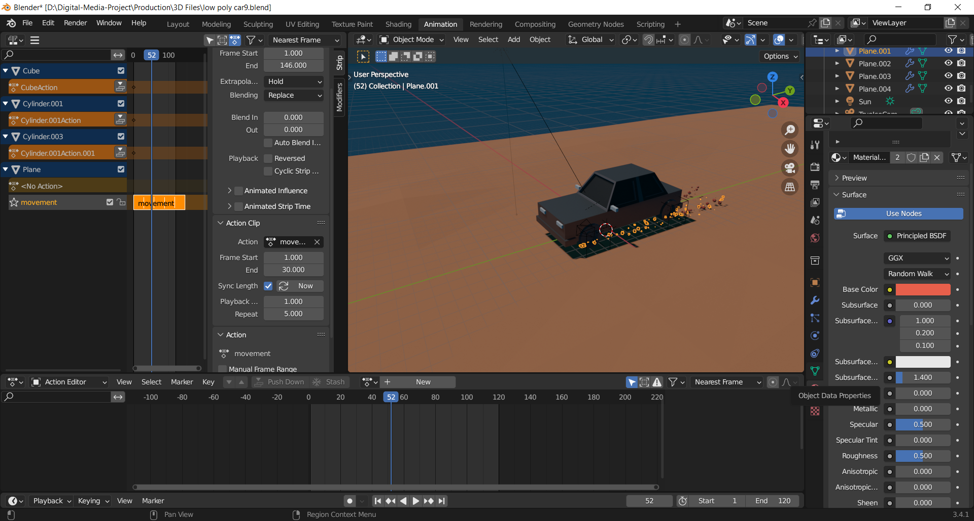
Shader setup

Slide 15
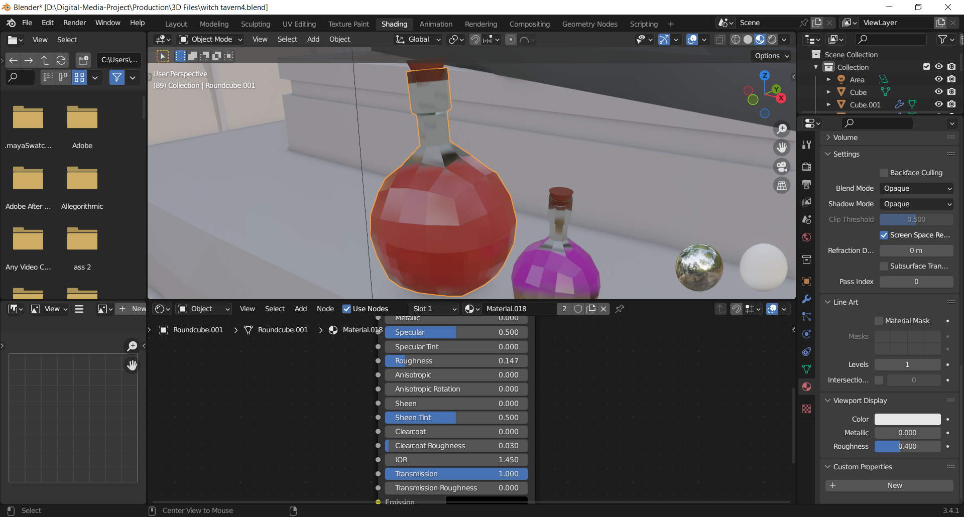
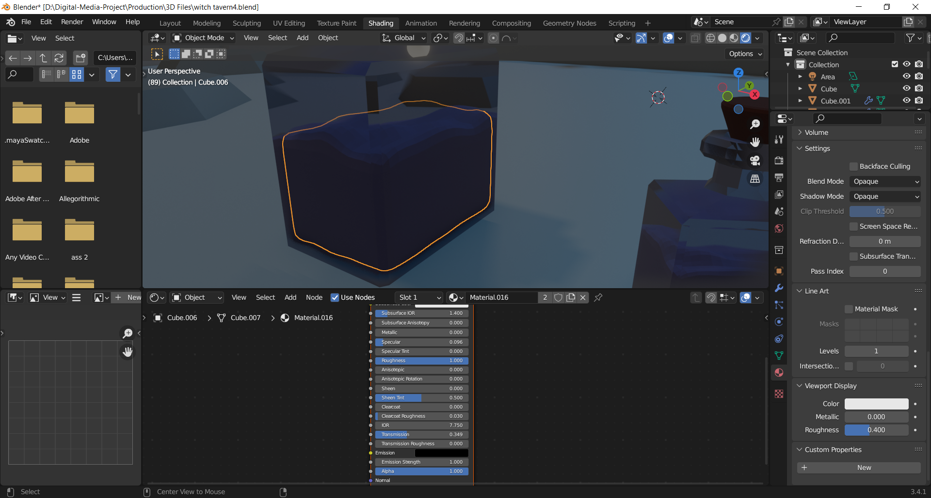
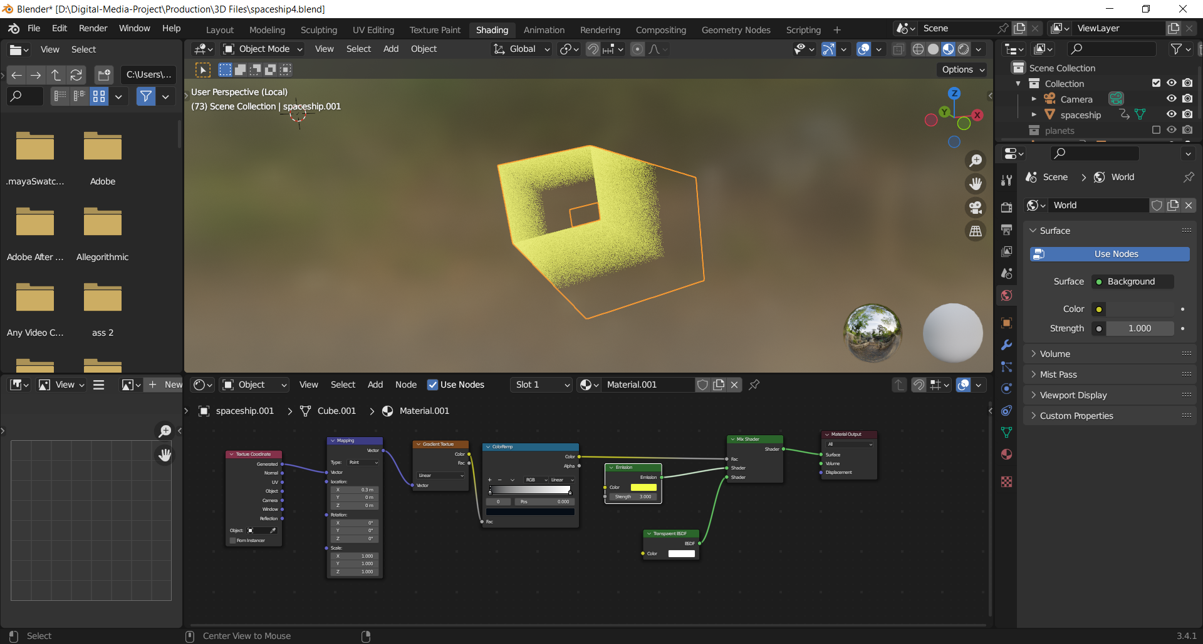
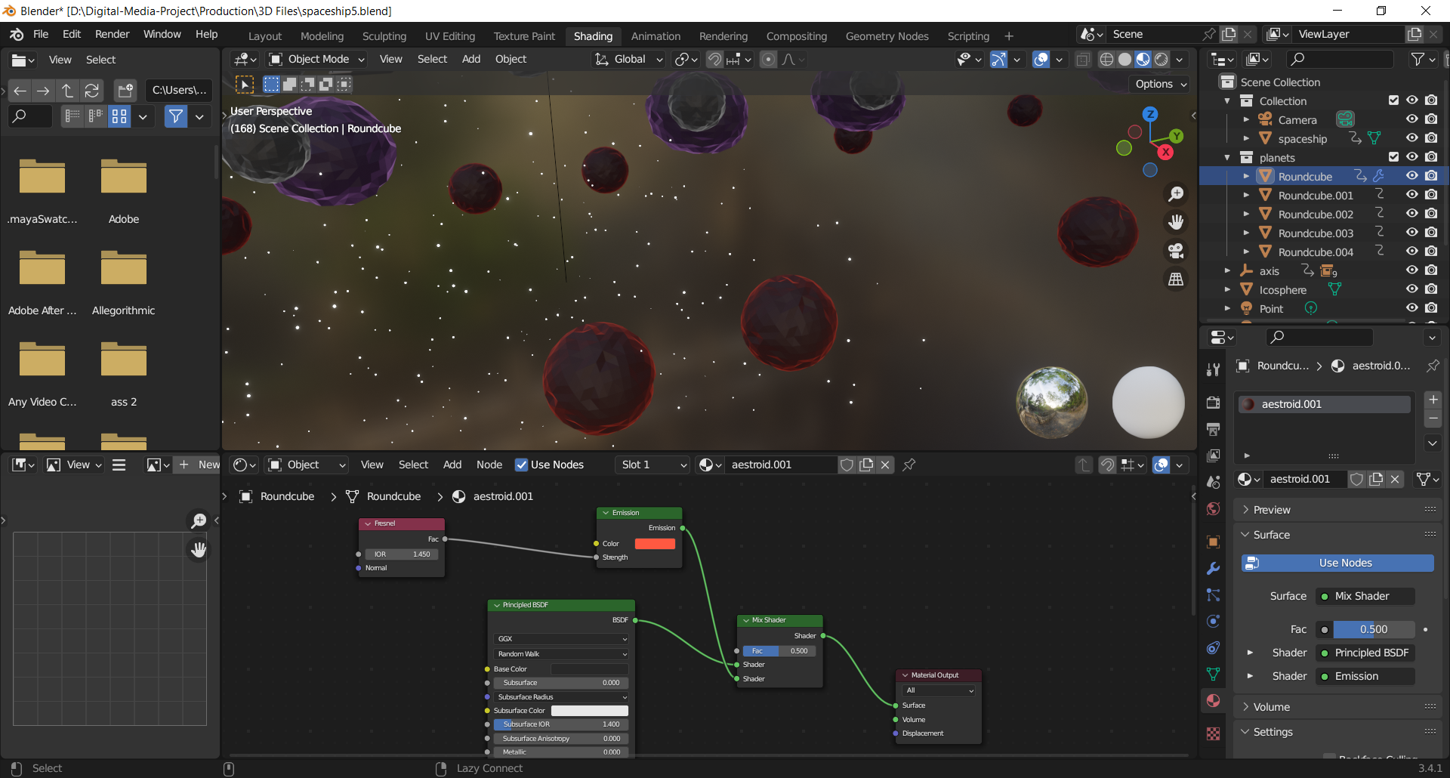

Slide 16
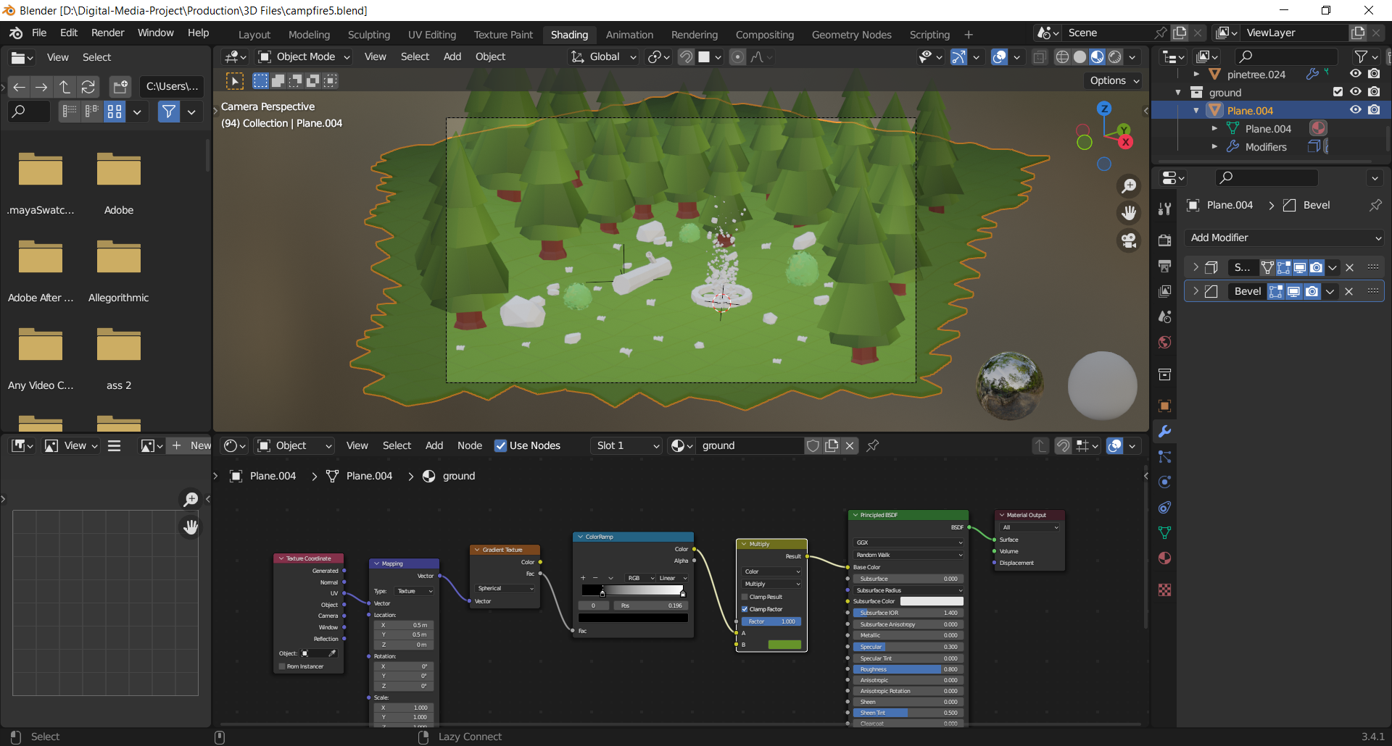
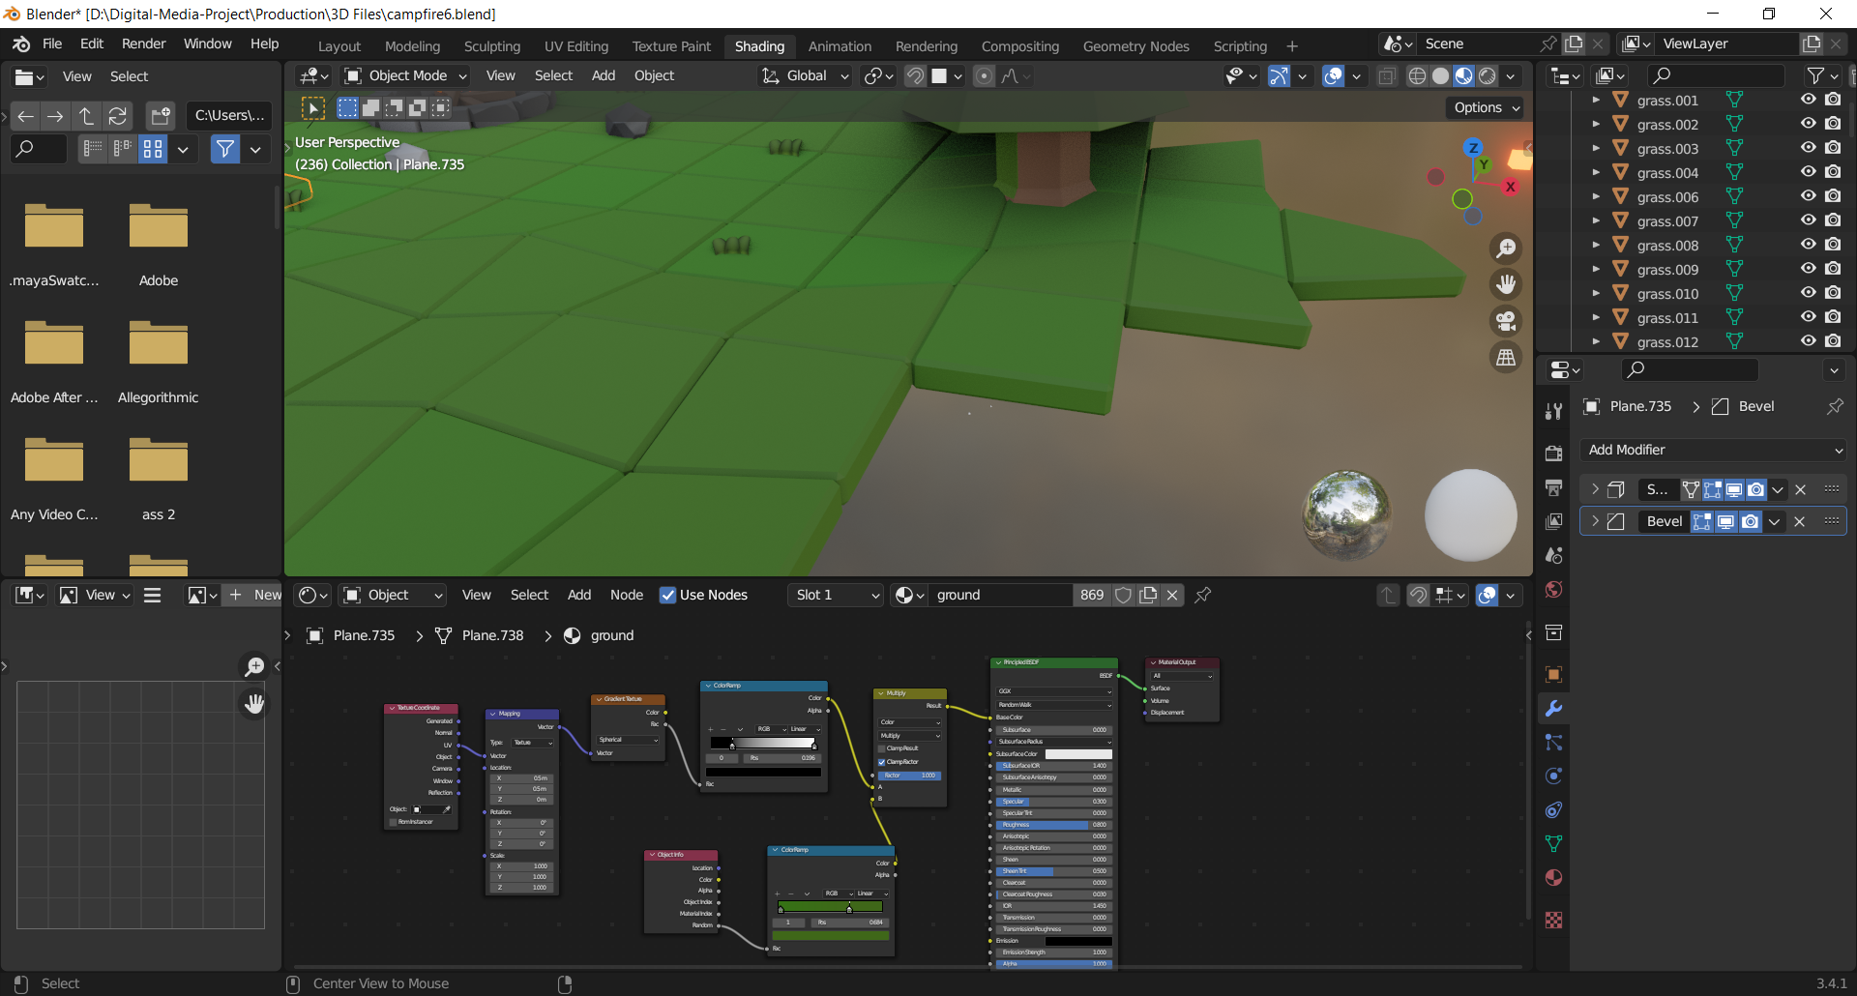

Slide 17
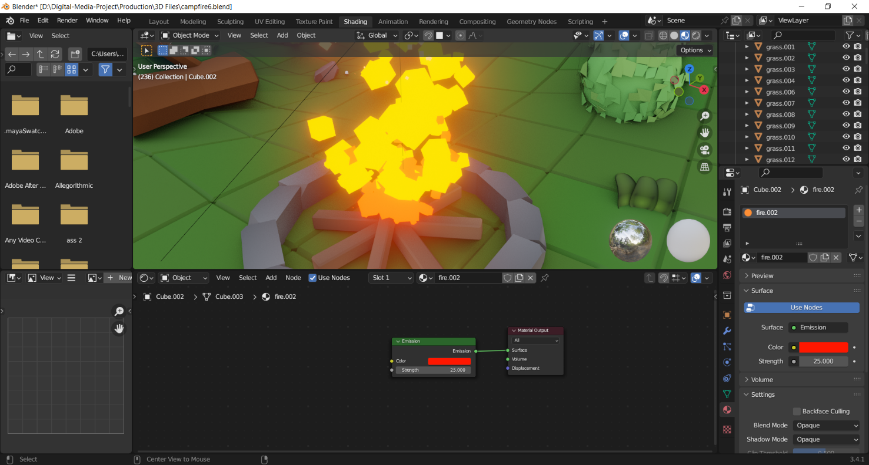

Slide 18
Post-production

Slide 19
Testing and Evaluation

Slide 21
Conclusion
Finally, I would like to thank my supervisors for their assistance with the project, I could not have finished it without their guidance.
This project has helped me learn and gain knowledge of the utilization of assets in the indie game industry.
It helped me in understanding about the scope and capabilities of my project.

